Slide 1
Chapter 1: Introduction

Slide 2
HISTORY OF PSYCHOLOGY (1)
Psychological perspectives
Structuralism – understanding the conscious experience through introspection.
Wilhelm Wundt
Functionalism – focused on how mental activities helped an organism adapt to its environment.
William James
Psychoanalytic Theory – focuses on the role of the unconscious in affecting conscious behavior.
Sigmund Freud

Slide 3
HISTORY OF PSYCHOLOGY (2)
Psychological perspectives
Gestalt Psychology – Focuses on humans as a whole rather than individual parts.
Wertheimer, Koffka, Kohler
Behaviorism – focuses on observing and controlling behavior.
Pavlov, Watson, Skinner
Humanism - emphasizes the potential for good that is innate to all humans.
Abraham Maslow and Carl Rogers

Slide 4
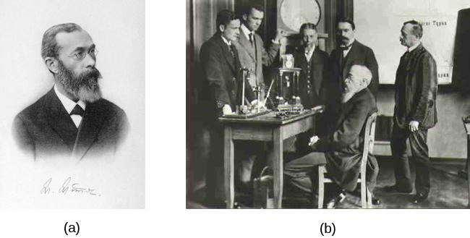
WILHELM WUNDT (STRUCTURALISM)
Wilhelm Wundt is credited as one of the founders of psychology.
Wundt emphasized structuralism. He focused on understanding the structure and characteristics of the mind through introspection.
Introspection - Process by which someone examines their own conscious experience in an attempt to break it into its component parts.
Notes:
Wundt created the first laboratory for psychological research.
Mind is composed of “sensations” and “feelings”

Slide 5
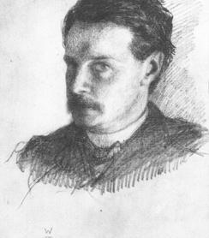
WILLIAM JAMES (FUNCTIONALISM)
William James: first American psychologist.
James drew from the functionality of cognitive processes, establishing functionalism.
Functionalism: how mental activities contributed to basic environmental survival.

Slide 6

SIGMUND FREUD
(PSYCHOANALYTIC THEORY)
Founded Psychoanalytic theory, a perspective which dominated clinical psychology for many decades.
Theorized that many of his patients’ problems arose from the unconscious mind.
Believed that one way the unconscious mind could be accessed was through dream analysis.
Psychoanalytic theory focuses on the role of a person’s unconscious and early childhood experiences.
Notes:
Studied “hysteria” and neurosis.

Slide 7
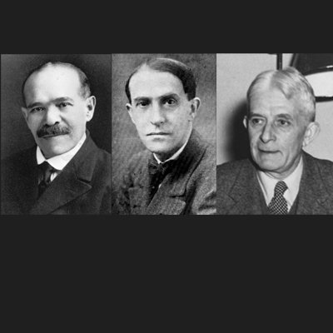
GESTALT PSYCHOLOGY
Kohler, Koffka and Wertheimer were German psychologists who immigrated to the U.S. to escape Nazi Germany.
Gestalt – “Whole”
Based on the idea that although a sensory experience can be broken down into individual parts, how those parts relate to each other as a whole is often what the individual responds to in perception.
Ideas of Gestalt continue to influence research on sensation and perception.

Slide 8

Notes:
Gestalt psychology never took off in the US. Overshadowed by behaviorism

Slide 9
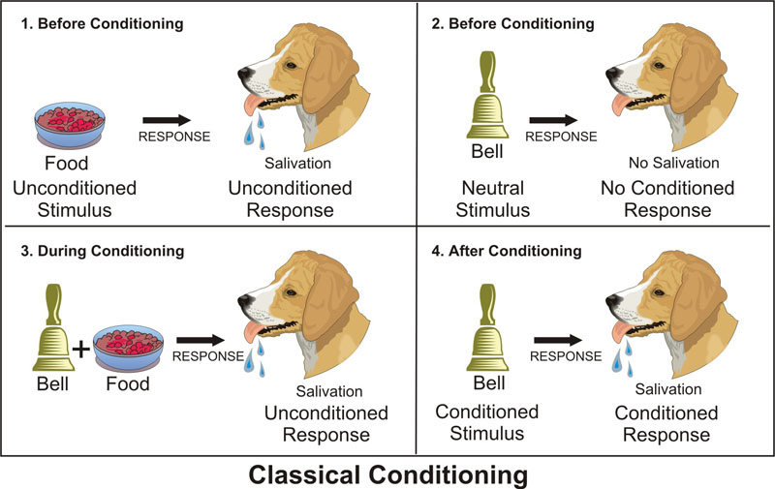
IVAN PAVLOV (CLASSICAL CONDITIONING)
Studied conditioned reflexes in which an animal produced a reflex (unconscious) response to a stimulus (salivating in the presence of food) and, over time, was conditioned to produce the response to a different stimulus (salivating to the sound of a bell) that the experimenter associated with the original stimulus (Food and bell became associated).

Slide 10
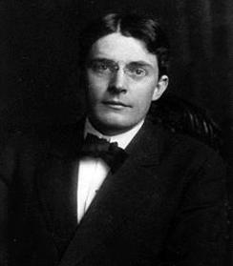
JOHN B. WATSON (BEHAVIORISM)
John B. Watson is known as the father of behaviorism within psychology.
Believed that objective analysis of the mind was impossible.
Focused on observable behavior and ways to bring that behavior under control
Today, behaviorism is used in behavioral and cognitive-behavioral therapy.

Slide 11
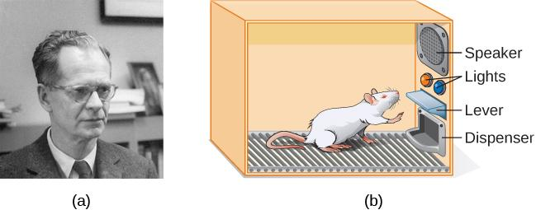
B.F. SKINNER (OPERANT CONDITIONING)
Concentrated on how behavior was affected by its consequences.
Studied the principles of modifying behavior through reinforcement and punishment which he saw as major factors in driving behavior (operant conditioning).
Notes:
Figure 1.7
B. F. Skinner is famous for his research on operant conditioning.
Modified versions of the operant conditioning chamber, or Skinner box, are still widely used in research settings today. (credit a: modification of work by "Silly rabbit"/Wikimedia Commons)

Slide 12

ABRAHAM MASLOW (HUMANISM)
Proposed a hierarchy of human needs in motivating behavior.
Maslow asserted that so long as basic needs necessary for survival were met (e.g., food, water, shelter), higher-level needs (e.g., social needs) would begin to motivate behavior.

Slide 13
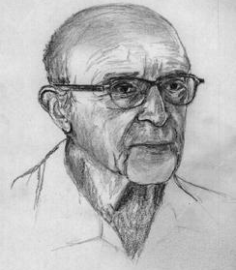
CARL ROGERS (HUMANISM)
Carl Rogers developed a client-centered therapy method that has been influential in clinical settings.
Client-centered therapy involves the patient taking a lead role in the therapy session.
Rogers believed therapists need:
unconditional positive regard
genuineness
empathy

Slide 14
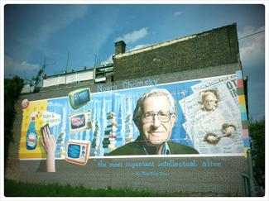
THE COGNITIVE REVOLUTION
By the 1950’s, new disciplinary perspectives in linguistics, neuroscience, and computer science were emerging.
The mind became the new focus of scientific inquiry.
Noam Chomsky
Noam Chomsky was influential in beginning the cognitive revolution.
He believed psychology needed to incorporate mental functioning into its focus in order to fully understand human behavior.

Slide 15
CONTEMPORARY PSYCHOLOGY
Branches of psychology
Biopsychology and Evolutionary Psychology
Sensation and Perception
Cognitive Psychology
Developmental Psychology
Personality Psychology
Social Psychology
Health Psychology
Industrial-Organizational Psychology
Sports and Exercise Psychology
Clinical Psychology
Forensic Psychology

Slide 16
BIOPSYCHOLOGY
Biological psychologists study how the structure and function of the nervous system generate behavior.
Research can include:
Sensory and motor systems
Sleep
Drug use and abuse
Ingestive behavior
Reproductive behavior
Neurodevelopment
Plasticity of the nervous system
Biological correlates of psychological disorders

Slide 17
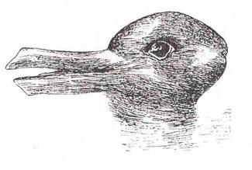
SENSATION AND PERCEPTION
This area of study focuses on both physiological aspects of sensory systems and the psychological experience of sensory information.
Sensation – Sensory information (sights, sounds, touch, smell).
Perception – Experience of the world which is influenced by where we focus our attention, our previous experiences, and our cultural backgrounds.

Slide 18
COGNITIVE PSYCHOLOGY
Branch of psychology that focuses on cognition and thoughts and their relationship to our experiences and our actions.
Attention
Problem solving
Language
Memory

Slide 19
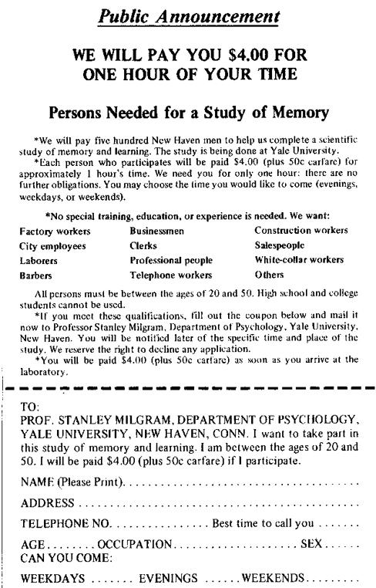
SOCIAL PSYCHOLOGY
How individuals interact and relate with others and how such interactions can affect behavior.
Prejudice
Attraction
Interpersonal conflicts
Obedience
Notes:
Figure 1.15 Stanley Milgram
Stanley Milgram’s research demonstrated just how far people will go in obeying orders from an authority figure. This advertisement was used to recruit subjects for his research.

Slide 20
INDUSTRIAL-ORGANIZATIONAL
Branch that applies psychological theories, principles and research to industrial and organizational settings.
Involves issues related to personnel management, organizational structure and workplace environment.

Slide 21
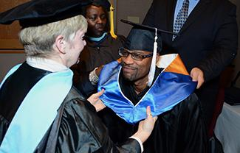
CAREERS IN PSYCHOLOGY
Most careers in psychology require a PhD or a Masters degree.
A few career options:
Teaching
Research
Clinical psychologist
Counseling psychologist
Social Work
Corporate and Marketing jobs

Slide 22
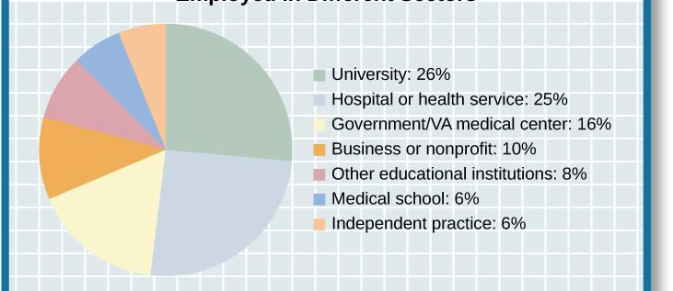
EMPLOYMENT IN DIFFERENT SECTORS
Figure 1.19 Individuals earning a PhD in psychology have a range of employment options.

